Slide 1
RAJALAKSHMI ENGINEERING COLLEGE
Department of Information Technology
SECOND REVIEW
STRESS DETECTION AND REDUCTION IN
IT PROFESSTIONALS
SUPERVISOR
Dr S.KAYALVIZHI B.Tech., M.E., Ph.D.
Assistant Professor (SG),
Department of IT, REC
TEAM MEMBERS
SREEKRISHNA P A(181001093)
SRIMANJEY R (181001095)
SUGUMARAN B(181001102)

Slide 2
OUTLINE
Abstract
Literature survey
Problem Definition
System Architecture
Module Description

Slide 3
ABSTRACT
Hence This system aims to develop a system to detect the stress level of IT professionals and provide them with remedies to reduce stress.
The system uses mini-Xception model to identify the emotions of the employees.
If a user is stressed, the system provides questionnaires to the employees, to analyse their stress.
The system also uses real time video of employees to detect the stress level.
The output of the two phases are computed to obtain final stress level.
Based on the stress level, it provides remedies to its employees.

Slide 4
LITERATURE SURVEY
Author/Year | Title | Methodology used | Advantages | Limitations
Brindahini Vimaleswaran/March 2021. | E – Therapy Improvement Monitoring Platform for Depression using Facial Emotion Detection of Youth | feed-forward Neural Network (FFNN), Principal Component Analysis(PCA). | When the system identifies that a user is depressed, it checks if there is any previously assessed depression. If the condition is true, then the data will be processed from the cloud and the input variable of previous depression level will be used for the calculation of improvement level of the patient. | The identification of depression and prediction of the therapy for an individual takes an average of two weeks.
Mohammad Rami Koujan , Luma Alharbawee , Giorgos Giannakakis , Nicolas Pugeault , Anastasios Roussos /January 2021 | Real-time Facial Expression Recognition “In The Wild” by Disentangling 3D Expression from Identity | ResNet CNN structure, TensorFlow. | Automatic recognition of human emotions from monocular images and is capable of estimating the 3D facial expression parameters from a single image. | 3D rendering needs to be customized and is expensive.
Abhishek Verma, Piyush Singh, John Sahaya Rani Alex /August 2019. | Modified Convolutional Neural Network Architecture Analysis for Facial Emotion Recognition | CNN using Venturi Architecture | The use of Venturi architecture provides more accuracy(90.54%) than rectangular and triangular architectures and has less training loss. It has better training and testing accuracy. | The training accuracy for Venturi architecture is 86.78%.
YUE LU , XINSHA FU , ENQIANG GUO , FENG TANG/January 2021. | XGBoost Algorithm-Based Monitoring Model for Urban Driving Stress: Combining Driving Behaviour, Driving Environment, and Route Familiarity | Xgboost, K-means 3d clustering analysis. | The use of Xgboost produces a strong classier with better classification or regression results by integrating several weak classifiers. | This system is limited as drivers face more difficulty when introduced to new routes.
Xianye Ben, Yi Ren, Junping Zhang, Su-Jing Wang, Kidiyo Kpalma, Weixiao Meng, Yong-Jin Liu/March 2021. | Video-based Facial Micro-Expression Analysis: A Survey of Datasets, Features and Algorithms | Deep CNN, Enriched Long-term Recurrent Convolutional Network (ELRCN). | The system can also be used to improve the accuracy of lie detection by accurately sensing the expression and identifying the emotions behind it. | The testing accuracy of the dataset is only 69.4%.
LITERATURE SURVEY

Slide 5
LITERATURE SURVEY
Author/Year | Title | Methodology used | Advantages | Limitations
iorgos Giannakakis , Mohammad Rami Koujan , Anastasios Roussos and Kostas Marias/June 2021. | Automatic stress detection evaluating models of facial action units. | SVM, Histograms of Oriented Gradients(HOG). | Both geometric and appearance features were extracted in order to enhance the estimation of the AU. | The classification accuracy is only 74.6% suing SVM.
Wheidima Carneiro de Melo, Eric Granger, Abdenour Hadid/September 2021. | A Deep Multiscale Spatiotemporal Network for Assessing Depression from Facial Dynamics | Multiscale Spatiotemporal Network , MTCNN. | MSN focuses mainly on facial area such as eyes and mouth. Hence the MSN explores more efficiently the spatio-temporal information. | The system can only detect depression and not any other emotions.
Ali Tazarvk, Sina Labbaf, Stephanie M. Reichy, Nikil Dutt;x, Amir M. Rahmaniz;;x, Marco Levorato/August 2021. | Personalized Stress Monitoring using Wearable Sensors in Everyday Settings | Multi Layer Perceptron (MLP), Random Forest (RF), k-Nearest Neighbourrs (KNN), Support Vector Machine (SVM), and XGBoost. | The system uses questionnaire to obtain feedback from user to asses their stress level. | The assessment of stress level has only two types. There is no middle emotion state.
Ryota Mitsuhashi, Kaito Iuchi,, Takashi Goto, Akira Matsubara, Takahiro Hirayama, Hideki Hashizume, Norimichi Tsumura/August 2020. | Video-Based Stress Level Measurement Using Imaging Photoplethysmography | KNN | The photoplethysmogram (PPG) signals help in accurately detecting whether the user is stressed or not and asks them for identifying their stress level. | Collecting photoplethysmogram (PPG) signals with enough labels collected from users in everyday settings is a challenging task.

Slide 6
PROBLEM DEFINITION
Stress in IT industry is skyrocketing as 43% of employees are reported to be stressed.
The existing systems identify stress in users but provide no mitigation to reduce the stress.
The aim of this study is to determine the stress level of an employee and provide remedies to reduce their stress.
The accuracy of the expected system is 90% in predicting the stress and the level of stress.
Our system provides an accuracy of more than 92% thereby creating a pleasant working environment that aims to satisfy both employees and the organization.

Slide 7
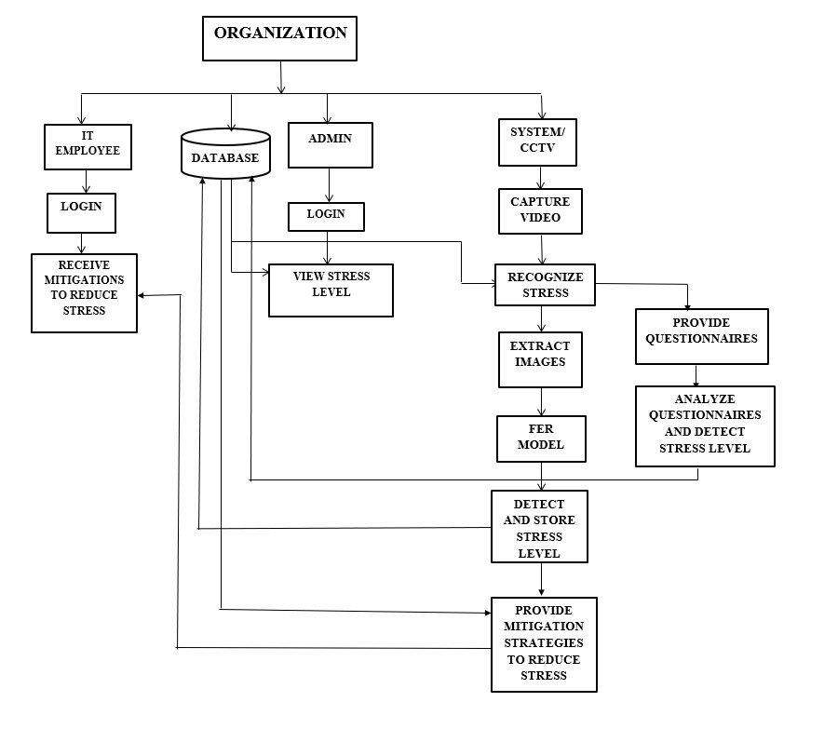
SYSTEM ARCHITECTURE

Slide 8
SYSTEM ARCHITECTURE
The organization consists of the following entities: Employee, Admin, System.
The system monitors the employees emotions at real-time through web-camera.
The system identifies 7 types of emotions such as: “happy”, “surprise”, “sad”, “angry”, “neutral”, “scared”.
The system identifies an employee to be stressed when the emotions such as ‘scared’, ‘sad’ .
When the system detects that an employee is stressed, it provides questionnaires to the employees.

Slide 9
SYSTEM ARCHITECTURE
The system also computes the stress level through real-time video.
The FER model is used to process the obtained images of the stressed employees and obtain their emotions.
Based on the results of the questionnaires and the detected stress level it computes the final stress level.
Based on the obtained final stress level, it provides mitigations to the employees.
The remedies provided to the employees depends on the obtained stress level.

Slide 10
MODULES
LOGIN Module:
This model allows the users and Admin to login.
Stress Detection Module:
This module is used to detect whether a user is stressed or not through video monitoring.
Stress Evaluation Module:
This module requires the user to provide feedback in case they are stressed and detect the stress level.
Stress Mitigation Module:
This module involves the system to provide remedies to stressed users. The remedy provided depends on the stress level of the user.

Slide 11
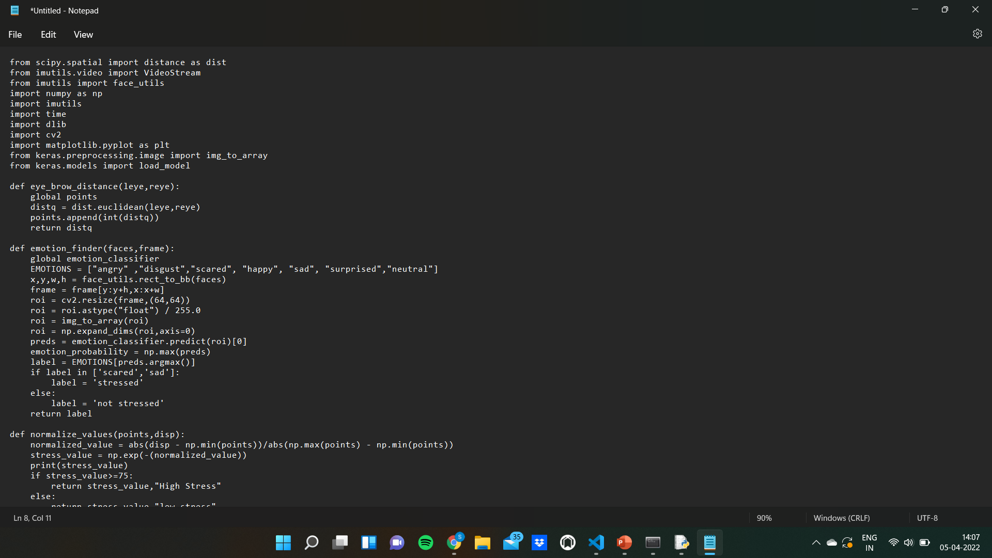
Eyebrow detection code
z

Slide 12
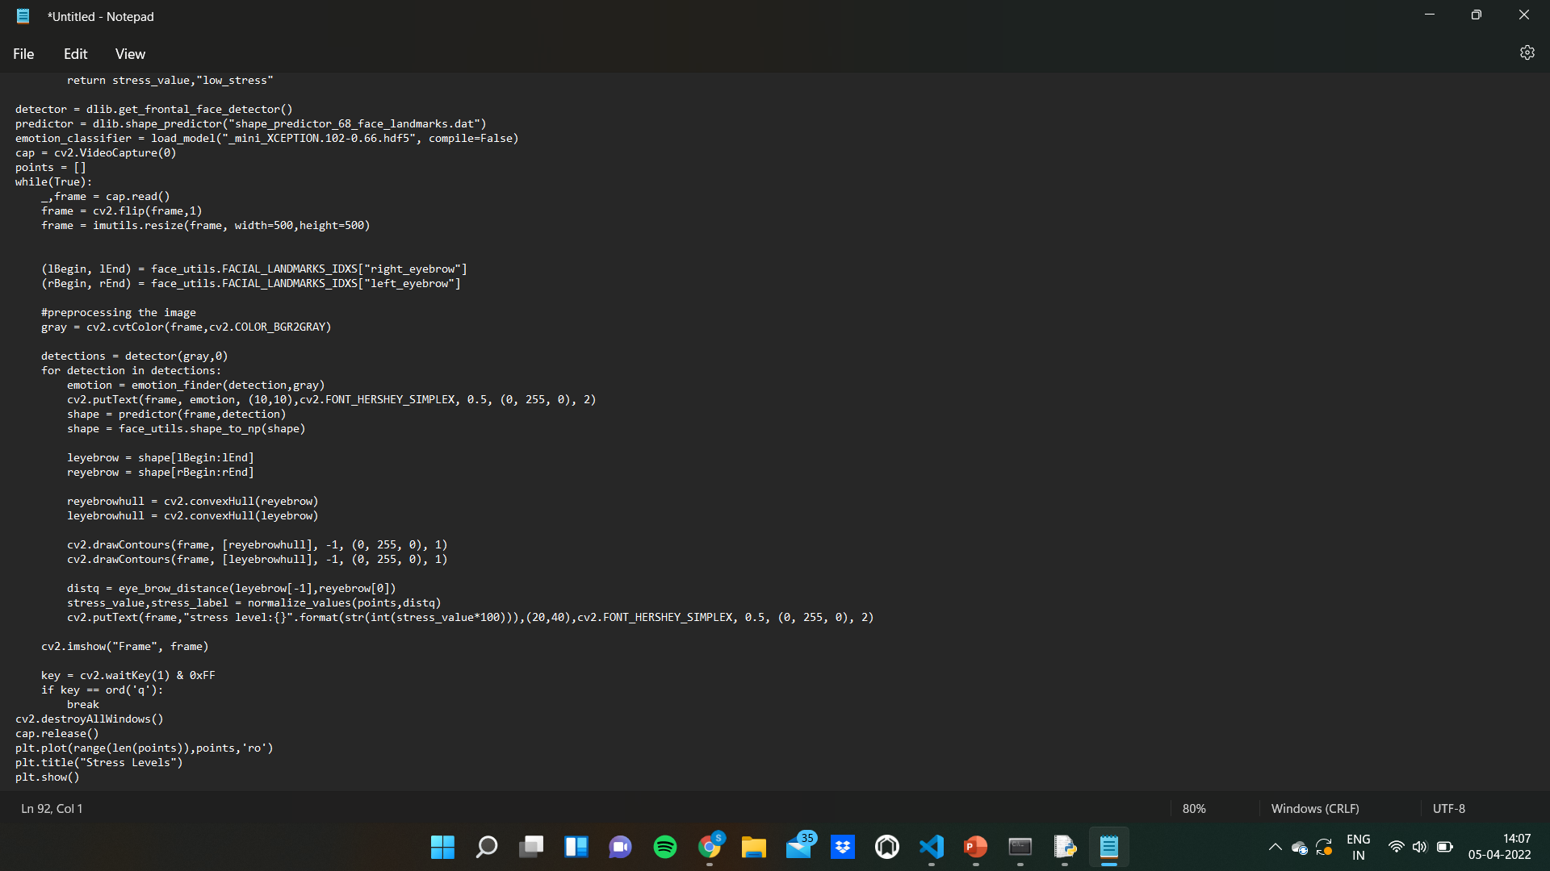
Eyebrow detection code
z

Slide 13
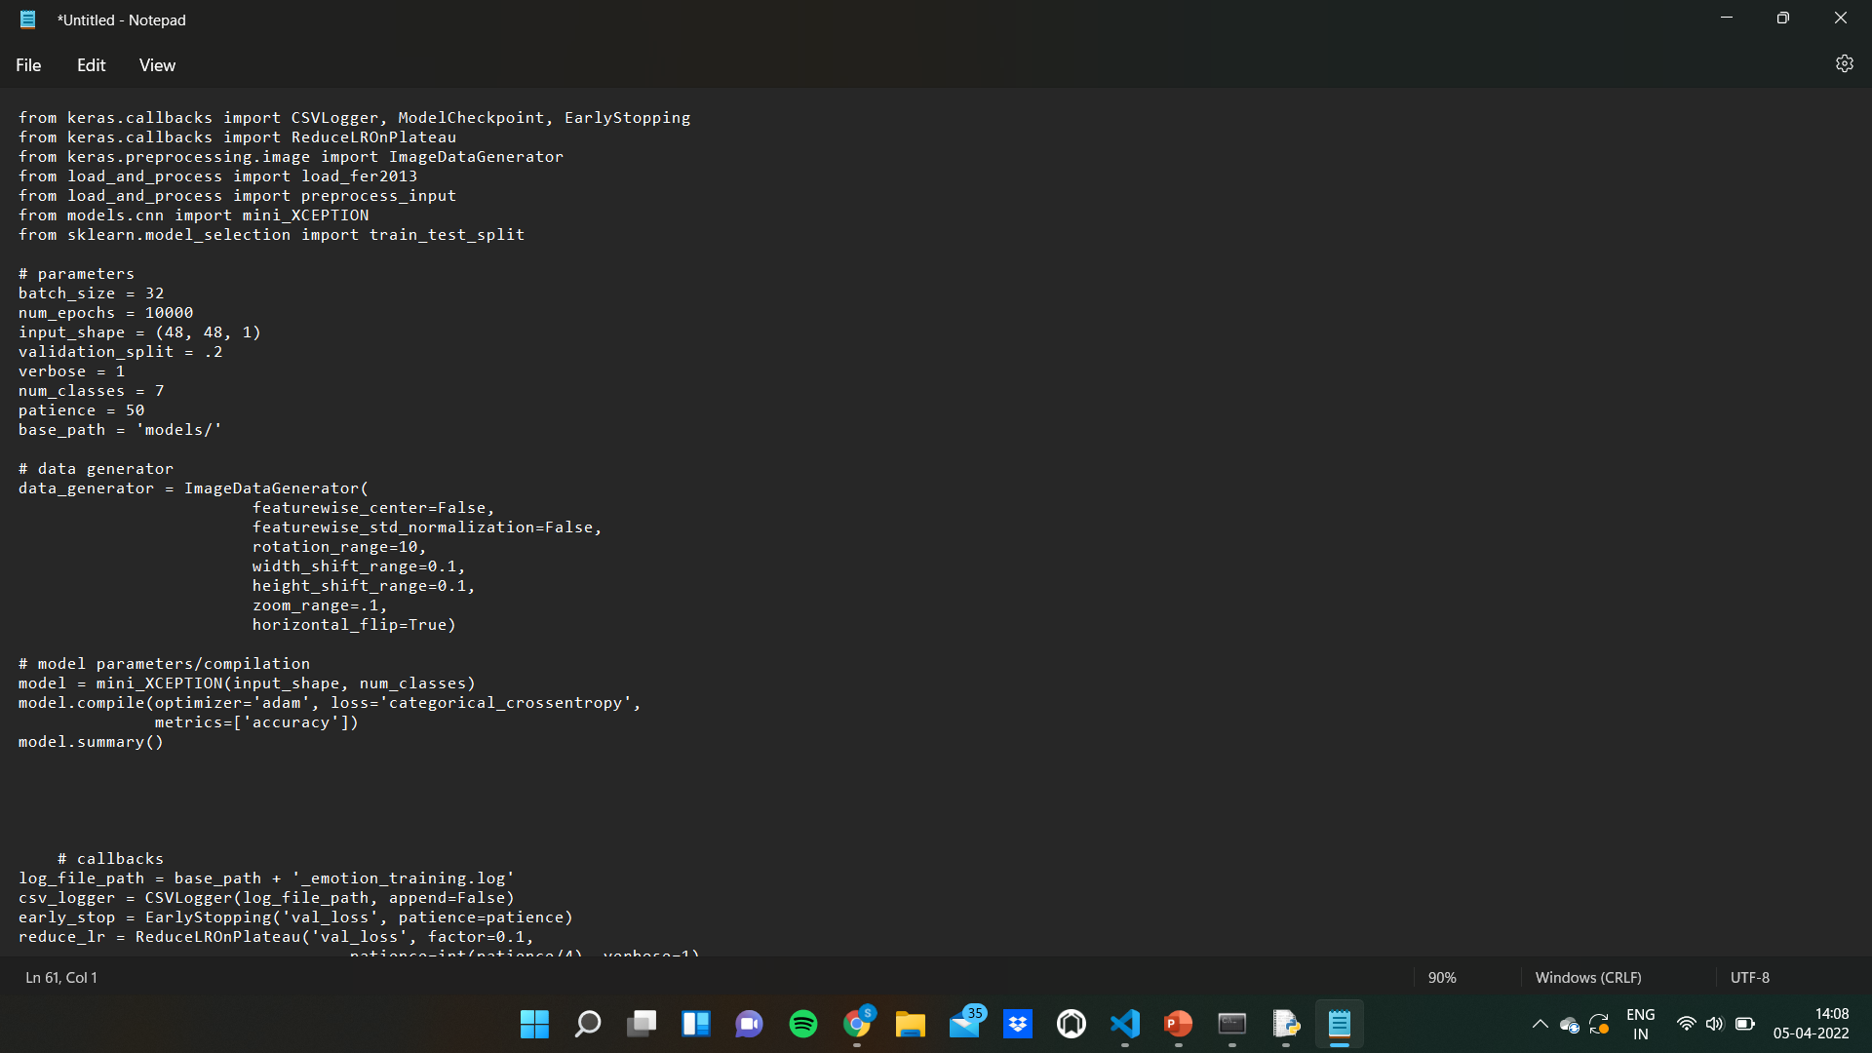
Emotion Recognition code
z

Slide 14
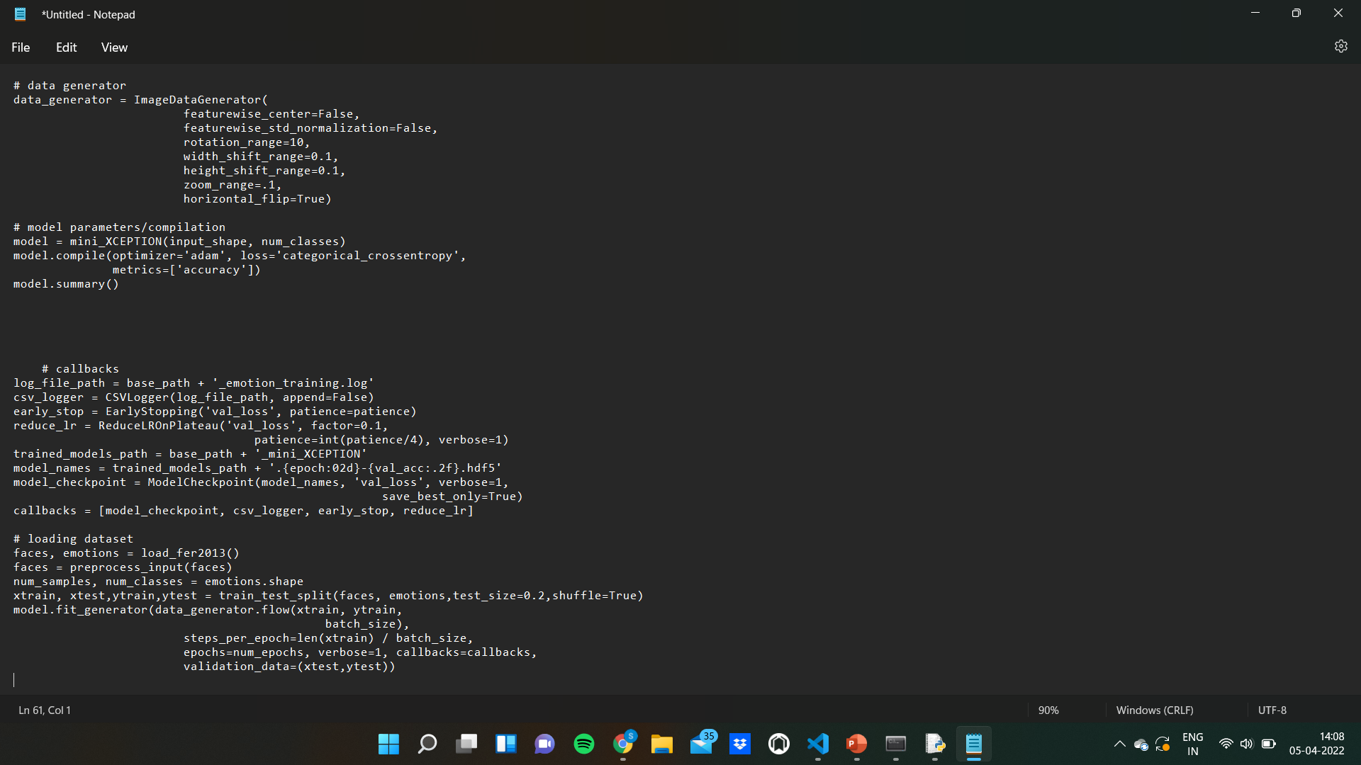
Emotion Recognition code
z

Slide 15
REFERENCES
References in IEEE Format
Brindahini VimaleswaranAndreoli, Gayashini Shyanka Ratnayake “E - Therapy Improvement Monitoring Platform for Depression using Facial Emotion Detection of Youth” 2021 Third International Conference on Intelligent Communication Technologies and Virtual Mobile Networks (ICICV) March 2021.
2. Mohammad Rami Koujan , Luma Alharbawee , Giorgos Giannakakis ,
Nicolas Pugeault , Anastasios Roussos “Real-time Facial Expression Recognition In The Wild by Disentangling 3D Expression from Identity” January 2021.
3. Abhishek Verma, Piyush Singh, John Sahaya Rani Alex “Modified Convolutional Neural Network Architecture Analysis for Facial Emotion Recognition “ August 2019.
4. Yue Lu,Xinsha Fu,Enqiang Guo,Feng Tang "XGBoost Algorithm-BaseMonitoring Model for Urban Driving Stress: Combining Driving Behaviour, Driving Environment, and Route Familiarity" January 2021.

Slide 16
REFERENCES
References in IEEE Format
5.Xianye Ben, Yi Ren, Junping Zhang, Su-Jing Wang, Kidiyo Kpalma, Weixiao Meng, Yong-Jin Liu “Video-based Facial Micro-Expression Analysis: A Survey of Datasets, Features and Algorithms” March 2021.
6. Iorgos Giannakakis , Mohammad Rami Koujan , Anastasios Roussos and Kostas Marias “Automatic stress detection evaluating models of facial action units” January 2021.
7. Wheidima Carneiro de Melo, Eric Granger, Abdenour Hadid “A Deep Multiscale Spatiotemporal Network for Assessing Depression from Facial Dynamics “ September 2020.
8. Ali Tazarvk, Sina Labbaf, Stephanie M. Reichy, Nikil Dutt , Amir M. Rahmani, Marco Levorato "Personalized Stress Monitoring using Wearable Sensors in Everyday Settings " March 2021.

Slide 17
REFERENCES
References in IEEE Format
9. “Video-Based Stress Level Measurement Using Imaging Photoplethysmography” Ryota Mitsuhashi, Kaito Iuchi,, Takashi Goto, Akira Matsubara, Takahiro Hirayama, Hideki Hashizume, Norimichi Tsumura ,August 2020.

Slide 18
THANK YOU

